Slide 1

Data Science and Modern Business

Slide 2
Goals
Introduce data science if you’re new, offer some advice if you’re not
Discuss common problems and techniques
Advice for non-stats majors
My path to becoming a data scientist / advice for stats majors
Key skills
Working in a data lab
Data Scientist’s toolbox / technical stack
Career outlook
Resources handout

Slide 3
What is Data Science?
The intersection of IT, computer science, statistics, machine learning, domain-specific competencies, and the scientific method
Most businesses generate too much data for any person or group to examine. The role of the data scientist is to use specialized techniques to sample and divine meaning from large quantities of data. These techniques must be paired with the scientific method and rigor to avoid false or misleading findings. For this reason, most data scientist work in groups who regularly audit each other's work.
It’s an absolute blast of a field to work in!

Slide 4
About Me
Began my career in oil and gas
BS Applied Statistics UHD class of 2016
MS Finance UHCL class of 2019
NRG Portfolio Management Analyst 2018 - 2021
Wood Mackenzie Data Scientist 2021
Now self-employed Data Scientist and Investment Manager

Slide 5
Common Problems and Techniques
Linear models
Non-linear models GLM
Survival analysis
Time series
KNN
SVMs
PCA
K-Means
Splines
Decision Trees
Neural networks
NLP
Statistical Learning
Supervised
Unsupervised
Regression
Classification
PCA
Clustering
*ISLR https://www.statlearning.com/
Great first book on data science

Slide 6
Examples
Regression
Buying rental homes, drivers for purchase/rent prices
Effectiveness of marketing campaigns
Time Series
Understand a firm’s cyclical patterns, i.e. energy usage
Used heavily in energy and finance
Survival Analysis
Modeling duration to an event of interest, i.e. customer attrition
Used heavily in manufacturing and businesses with subscribers
Classification
Segmentation, i.e. bucketing bank customers into credit risk categories

Slide 7
Advice for Non-Stats Majors
Data scientists were regular fixtures at NRG, even in marketing meetings
IT is more and more important. SQL is becoming almost as necessary as Excel, which is ubiquitous. Companies generate enormous amounts of data
Even being somewhat knowledgeable about things like decision trees can help you engage with data professionals, and give you a leg up over those who cannot
*ISLR https://www.statlearning.com/
Great first book on data science

Slide 8
My Path to Data Science
B.S. Applied Statistics UHD
Worked in analytics while completing my M.S. Finance
Joined an advanced analytics team at NRG. Lots of programming, database work, and modeling
Read a giant stack of stats/data science/programming books for three years while working and crashing the data science team meetings at NRG
Passed SOA Exam P, and read the manuals for both data science exams they offer: SRM, and PA (also FM and IFM)
Performed well on a technical interview for WoodMac and was hired at a senior level.

Slide 9
Data Science Lab
Team
Principal scientist
Data scientists
Data engineer
Machine learning engineers
Assistants
Workflow
Accept projects from various clients or business units
Kick-off meetings
Checking out resources from the cloud
Data gathering / EDA
Modeling
Stand-ups and iteration with stakeholder
Production (completed model or dashboard)
Publication

Slide 10
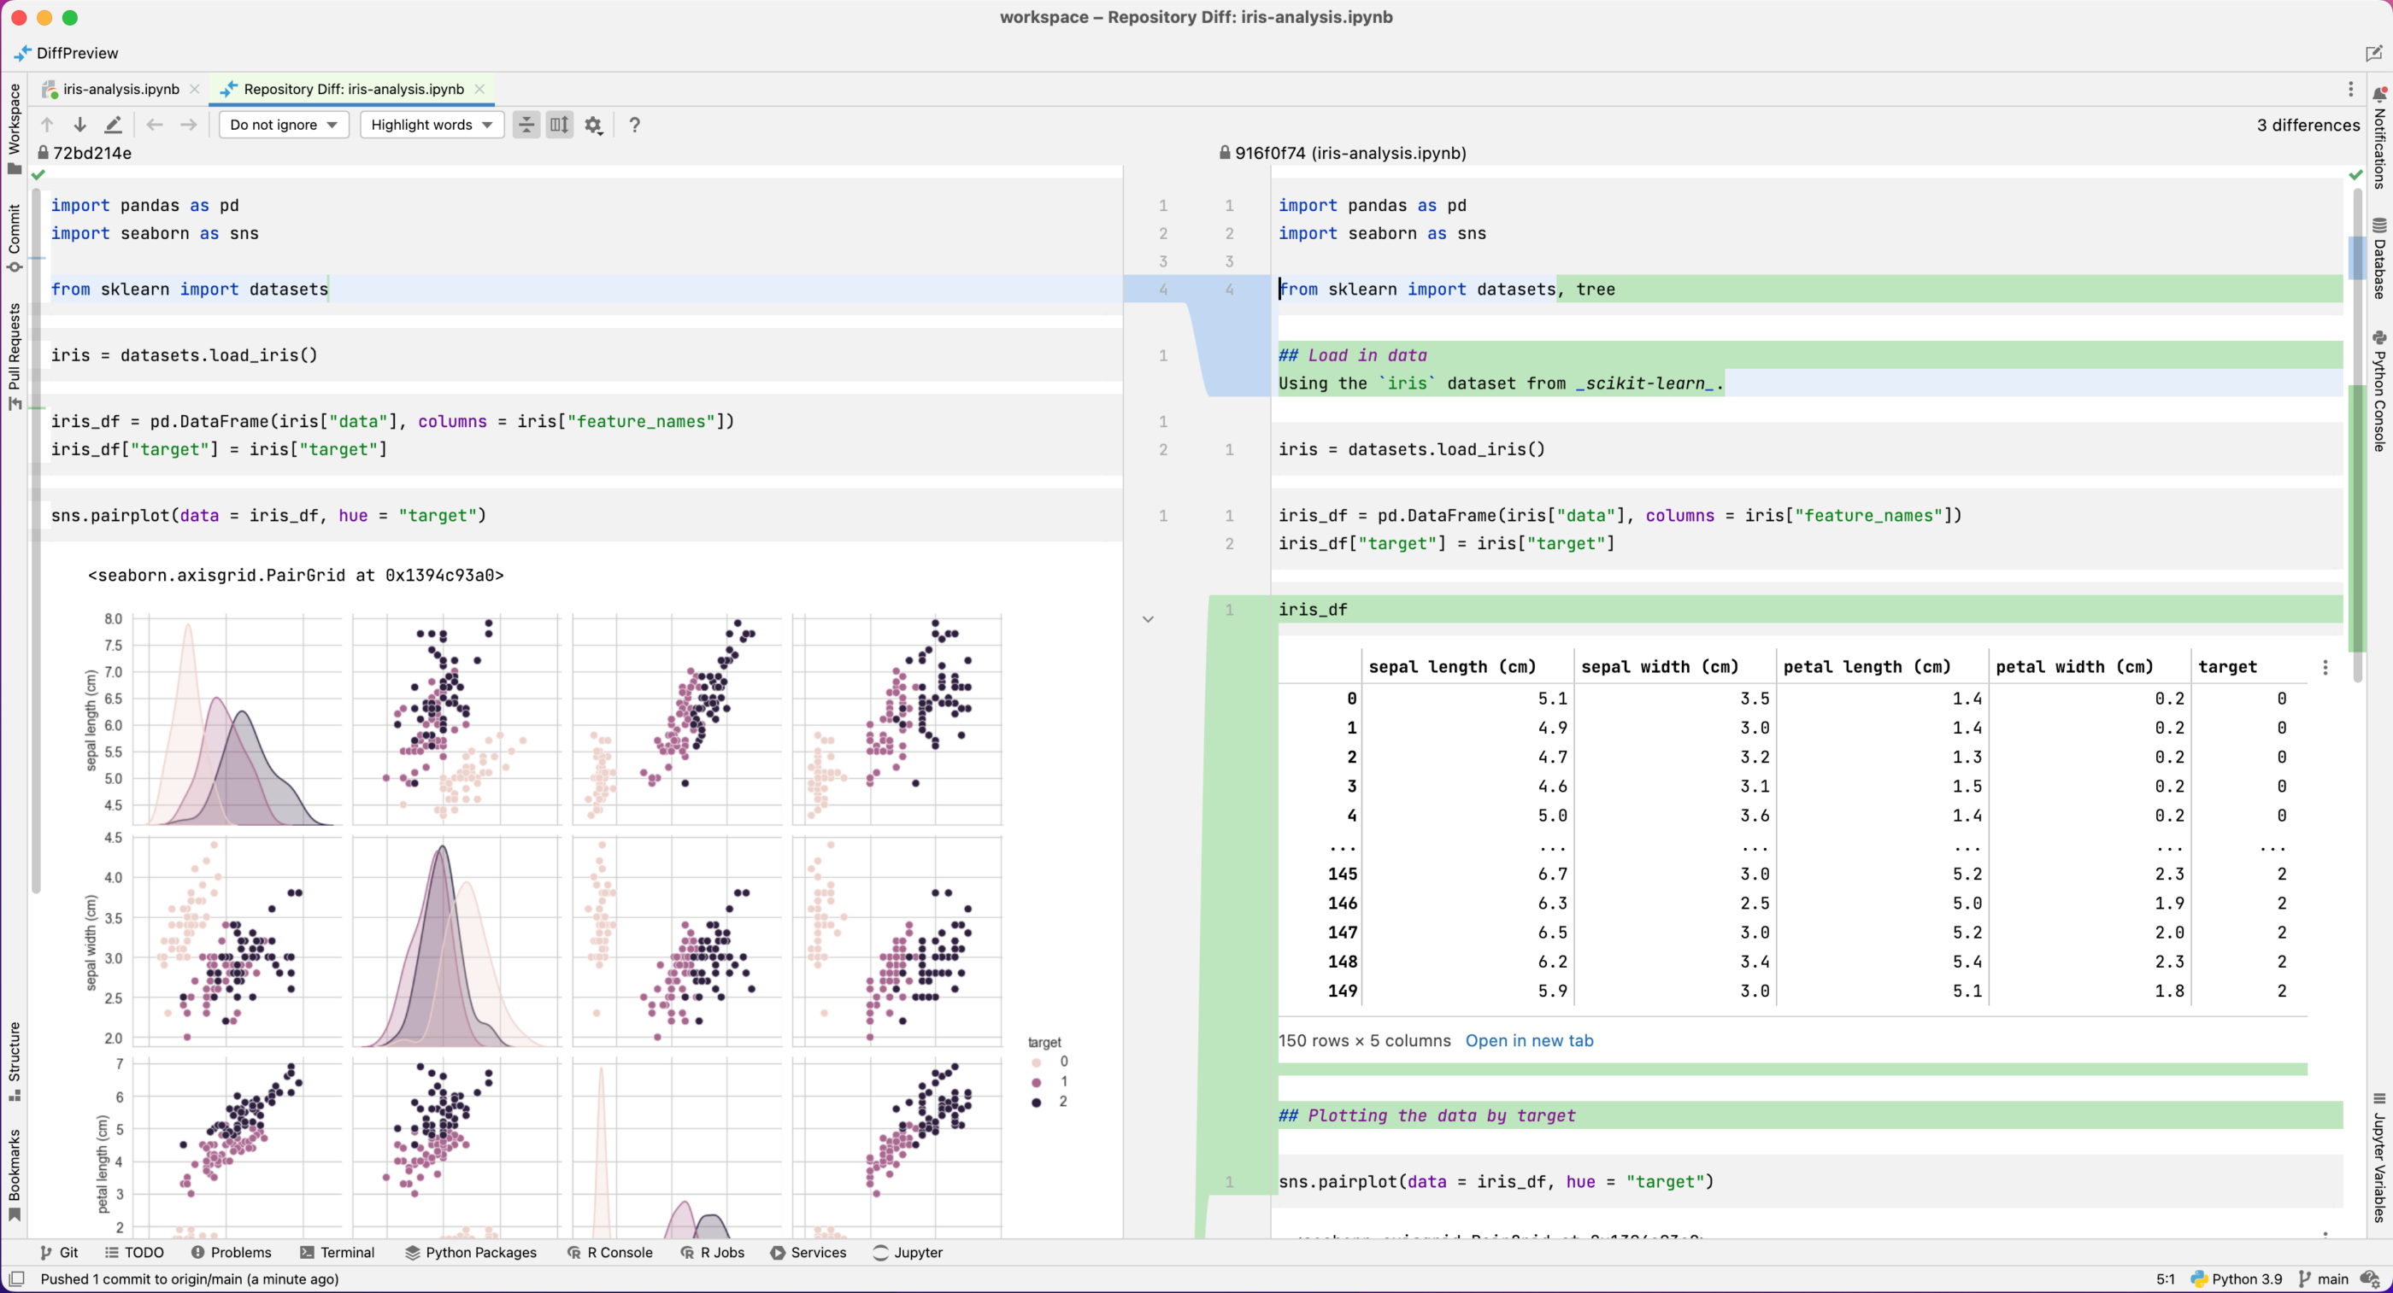
Notebooks

Slide 11
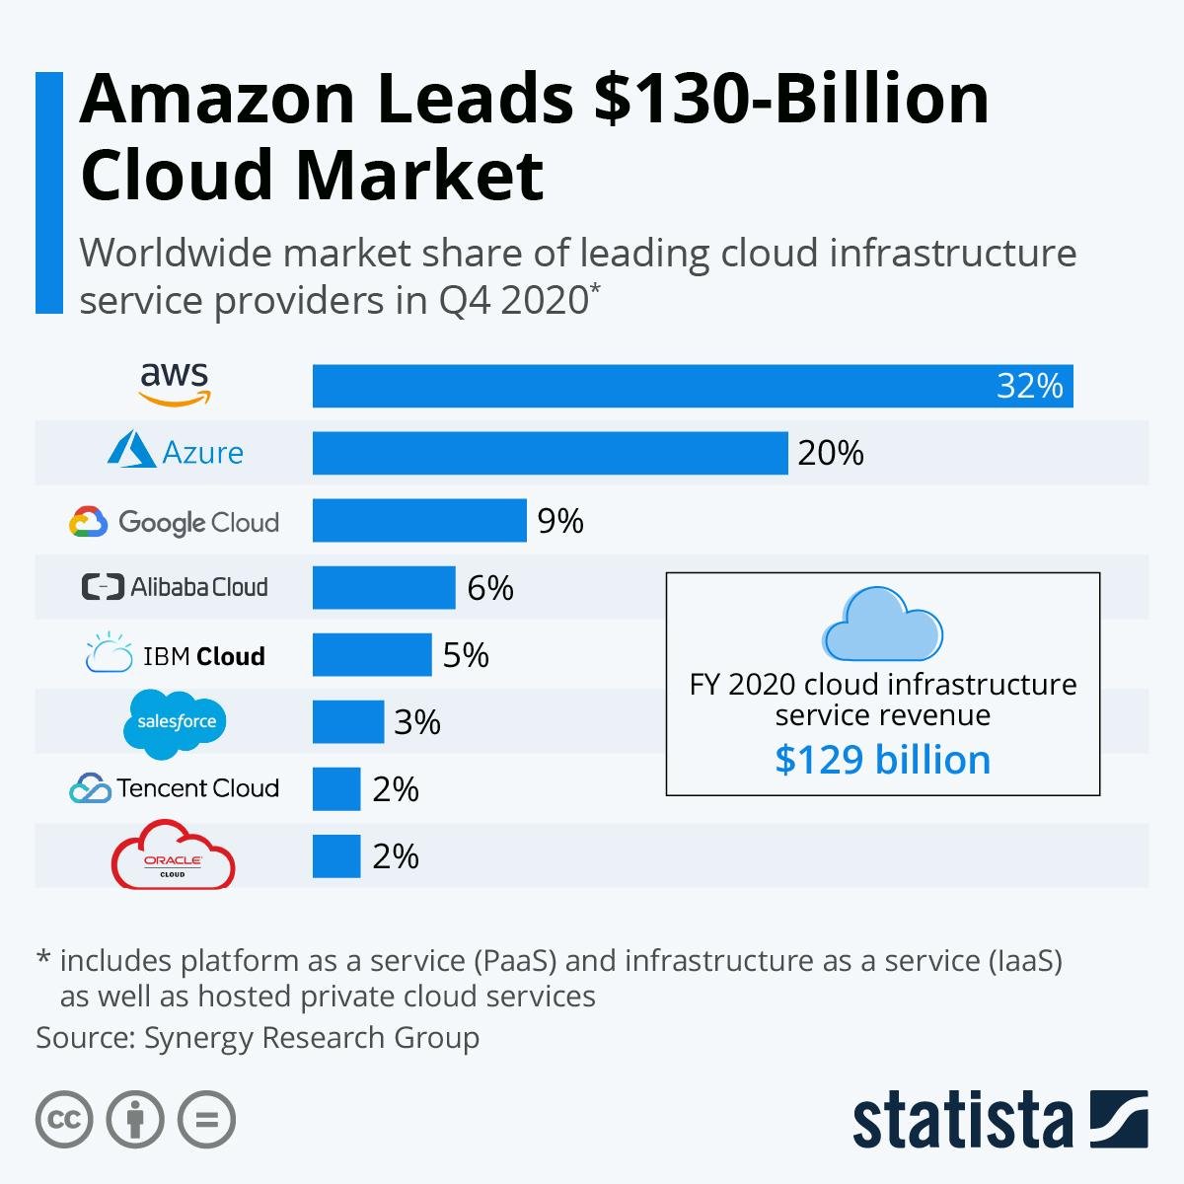
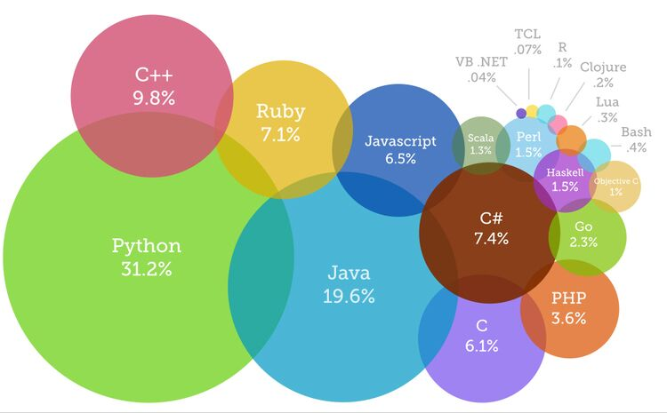
Technical Stack
Python - AWS - Jupyter Notebooks - Pycharm - VS Code - Git - Numpy - Pandas - PySpark - Plotly - Dash – PyTorch - Docker
https://perfectial.com/blog/lets-face-the-cloud-choice-aws-vs-azure-vs-gcp/
https://www.devsaran.com/blog/10-best-programming-languages-2020-you-should-know

Slide 12
Key Skills
Communication and EQ
Probability and Statistics
Programming in at least one functional language, preferably Python
Data Visualization
Cloud Computing - AWS, Azure, or Google Cloud
Version Control (git)
Judgement. Managing a large toolset takes time and practice

Slide 13
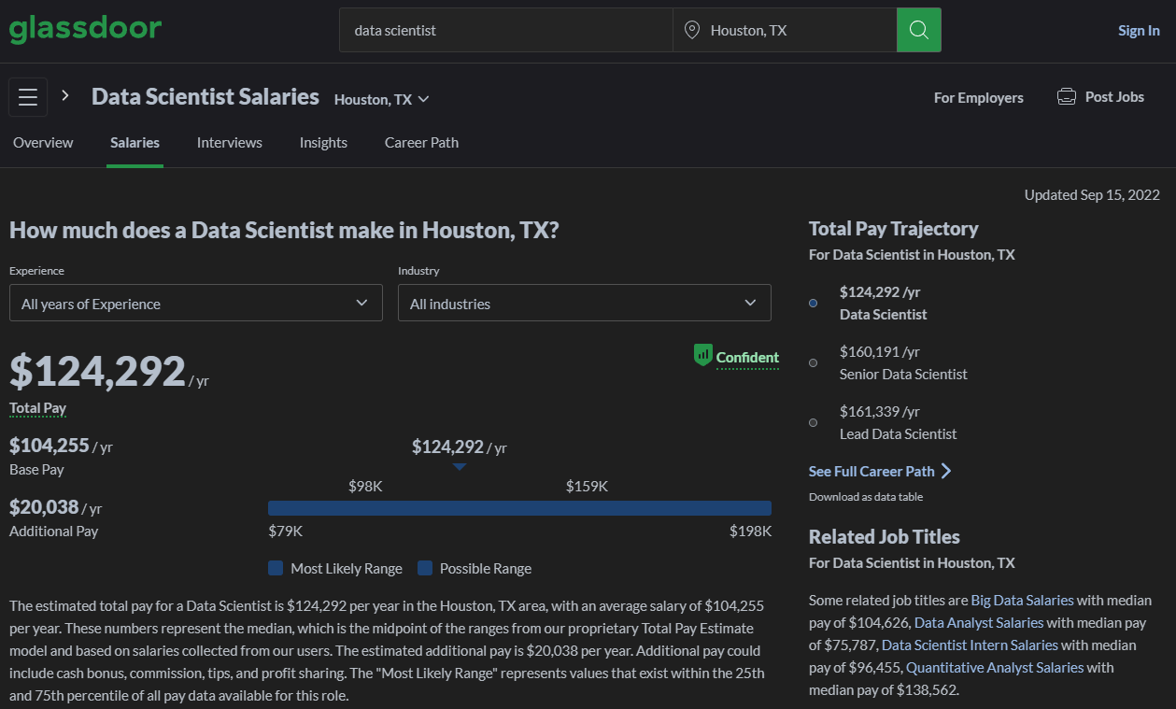
Outlook and Pay

Slide 14
Advice for Stats Majors
Write lots of code and practice communication. Your two main activities will be programming and going to meetings
I did not choose a Master’s in DS or Stats because I was learning advanced stats from other sources. If you’re doing an MS in Stats, consider learning another domain on your own to compliment
Know your distributions and the mathy side of data science. SOA manuals are great for this. Deep learning is all over the news, but traditional methods are what you see day-to-day
A good milestone is when you can write a long, complex Monte-Carlo simulation from scratch using multiple distributions and visualize results with a variety of plots
Data visualization is a key skill and is much more important than you think it is. Learn the Github/kaggle is your real resume
The best time to learn Git was yesterday
Udemy/Datacamp fine for first steps, but move past superficial learning materials. Technical interviews will test whether you really understand the techniques
Python is the lingua franca of modern data science, but learn some SAS and R as well. Books focusing on R tend to be deeper than those written for Python
Learn every day. At WoodMac we had one day per week of protected study time
Don’t feel like you need to learn every single technique. Focus on what you like. You’ll be a part of a team. I was “the GLM guy” at WoodMac
Decision trees and time series are both very popular. Learn bagging, boosting, random forests, and TS topics thru SARIMAX

Slide 15
Resources Recommendations
Generalized Linear Models With Examples in R (Springer Texts in Statistics) 1st ed. 2018 Edition 978-1441901170
Fluent Python ISBN: 9781492056355
Python for Data Analysis https://wesmckinney.com/book/
R for Data Science https://r4ds.had.co.nz/
Data Visualization https://socviz.co/
“Grammar of Graphics” https://byrneslab.net/classes/biol607/readings/wickham_layered-grammar.pdf
Actex Manuals for SOA Exams P, SRM, PA www.actuarialbookstore.com
An Introduction to Statistical Learning (ISLR) https://www.statlearning.com/

Slide 16
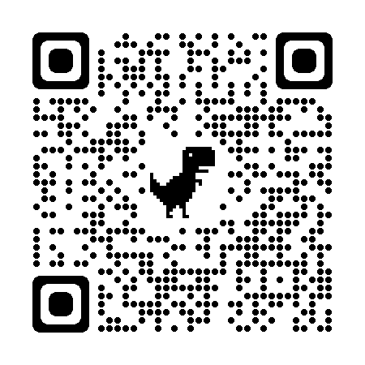
Link to Presentation

